Slide 1

CAPSTONE PROJECT
AI – BASED LOAN ELIGIBILITY PREDICTION
AND RISK ASSESSMENT SYSTEM
CSA0905 – JAVA PROGRAMMING
UNDER THE SUPERVISION OF:
DR.SIVASANKAR C
PRESENTED BY: CH. HARSHITHA - 192473031
G. BHAVYA – 192411114
K. JAHNAVI - 192424242

Slide 2


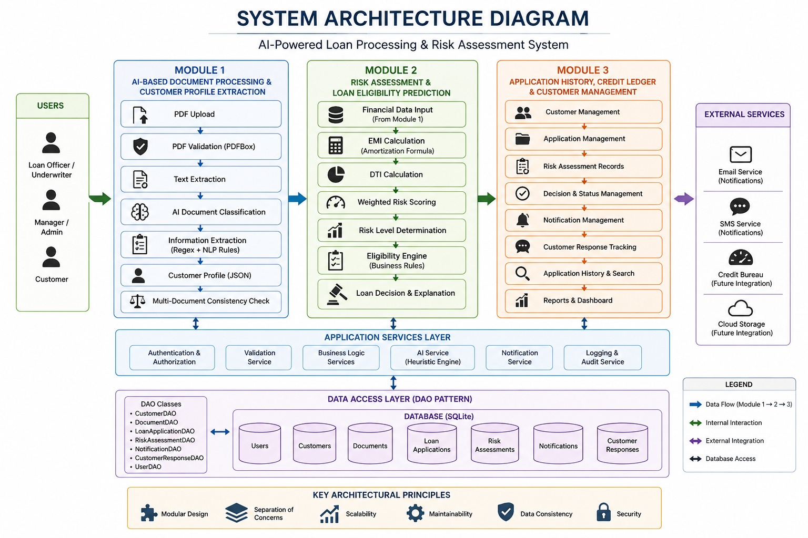
SYSTEM ARCHITECTURE

Slide 3
MODULE DESIGN
Module 1 — AI-Based Document Processing
This module validates financial PDFs, extracts text, identifies loan-related documents, and extracts
important customer and financial information to create a structured customer profile.
Data Flow:
PDF → Validation → Text Extraction → Classification → Information Extraction → Customer Profile
Module 2 — Risk Assessment & Eligibility
This module evaluates the applicant's financial profile using EMI, DTI, weighted risk scoring and
predefined eligibility rules to generate an explainable loan decision.
Data Flow:
Customer Profile → EMI → DTI → Risk Score → Risk Level → Eligibility
Module 3 — Application & Credit Ledger
This module manages customer records, application history, risk assessments, decisions, notifications and
customer responses.
Data Flow:
Decision → Database → Application History → Notifications → Customer Response

Slide 4
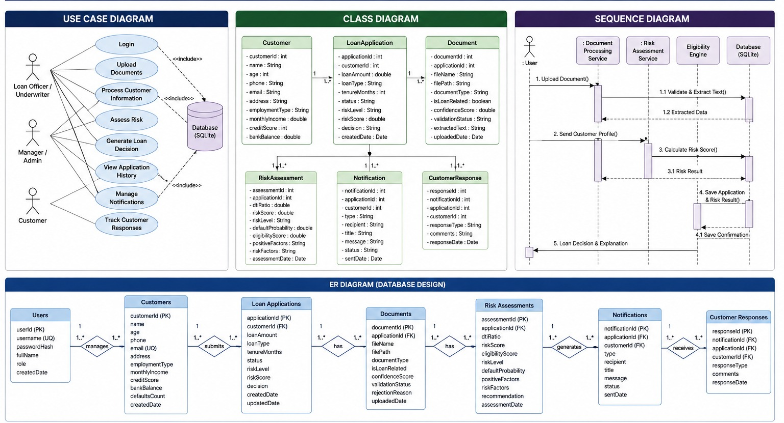
UML & DATABASE DESIGN

Slide 5
TECHNOLOGY STACK
Programming & Development
Java 25 – Core application development
Apache Maven – Build and dependency management
Java Swing – Desktop graphical user interface
AI & Document Processing
Heuristic AI / Rule-Based NLP – Document classification
Apache PDFBox 3.0.4 – PDF validation and text extraction
Java Regex – Customer and financial information extraction
org.json – Structured data processing
Database & TestingSQLite 3 – Data persistence
JDBC – Database connectivity
DAO Pattern – Database abstraction

Slide 6
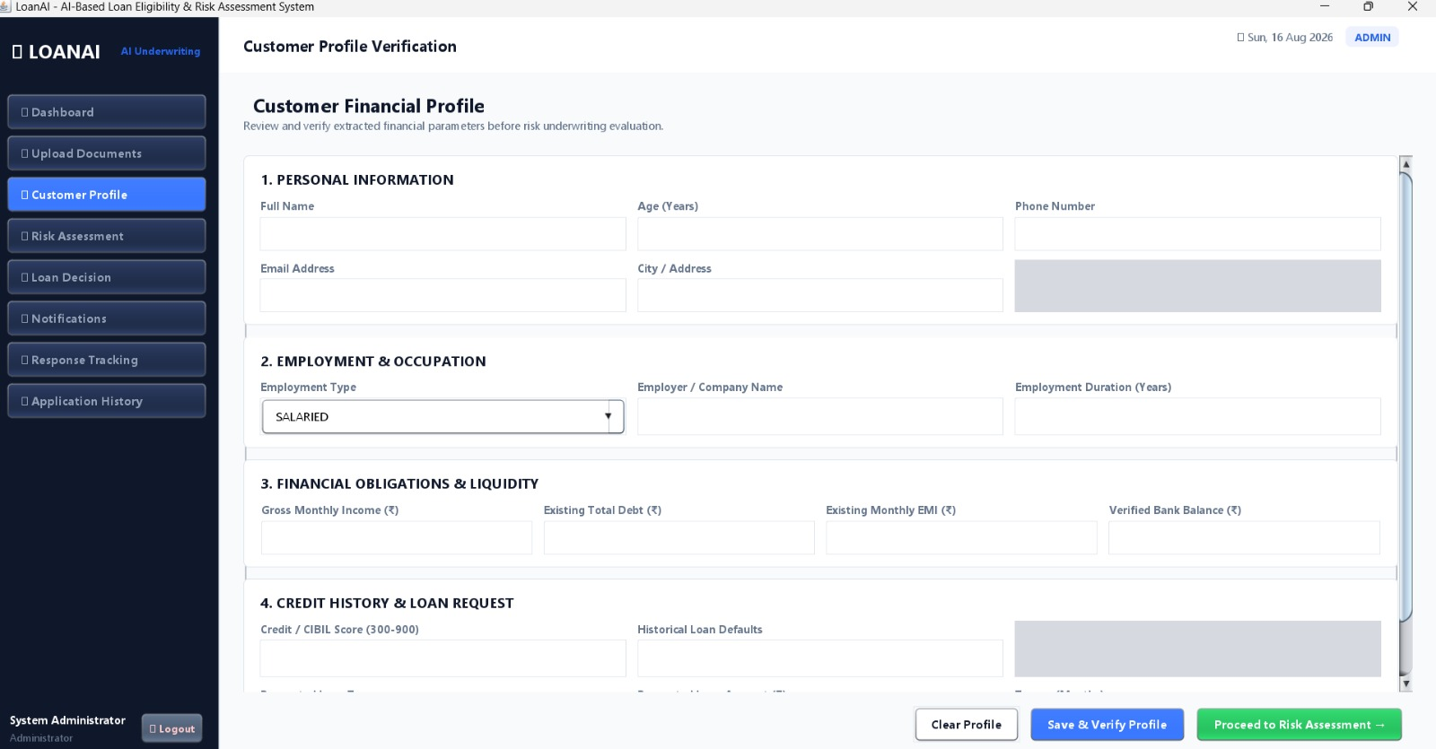
IMPLEMENTATION
MODULE 1 : AI-Based Document Processing & Customer Profile Extraction

Slide 7
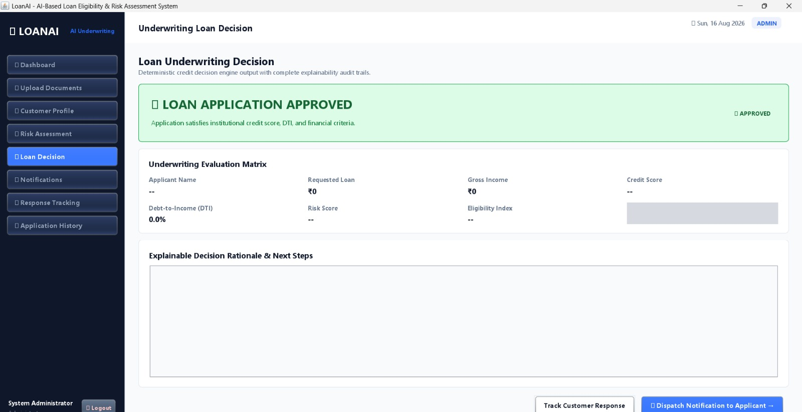
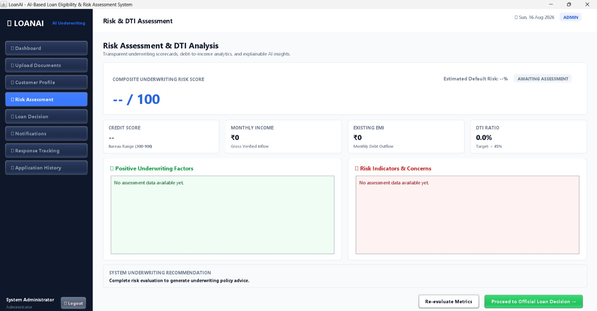
MODULE 2 — Risk Assessment & Loan Eligibility Prediction

Slide 8
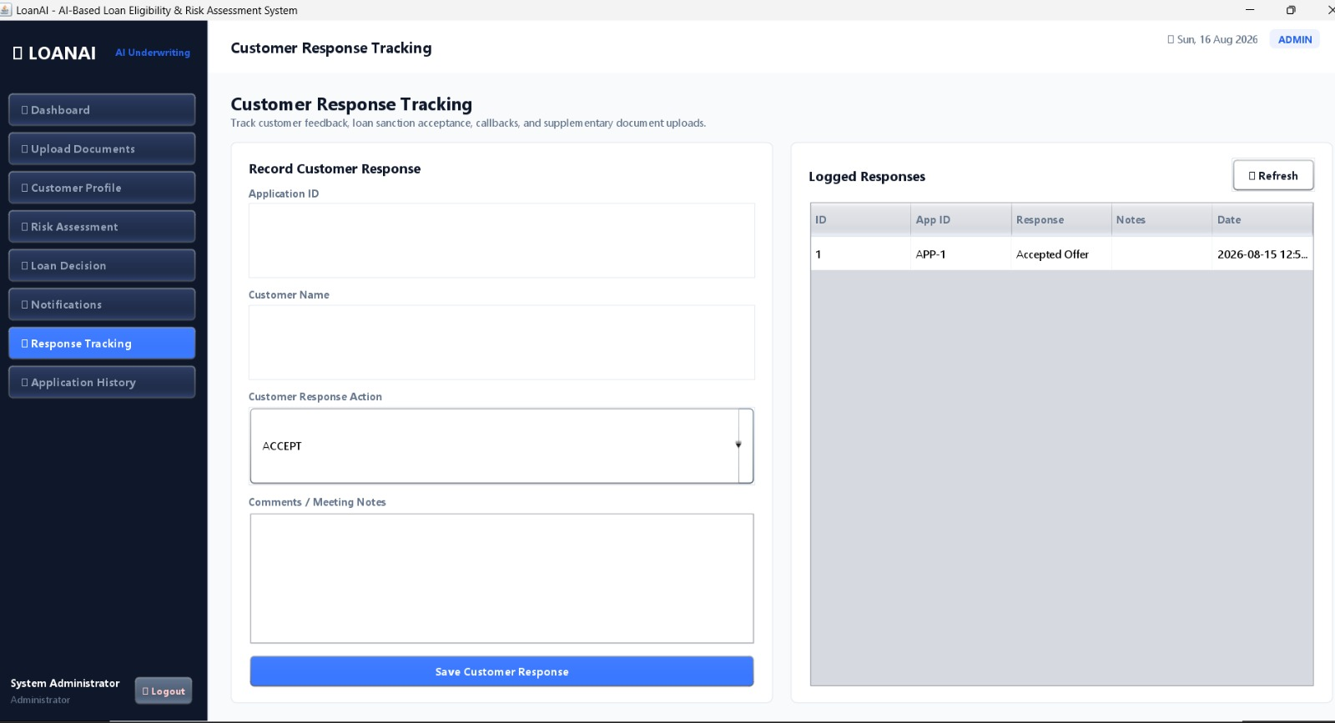
MODULE 3 — Application History, Credit Ledger & Customer Management

Slide 9
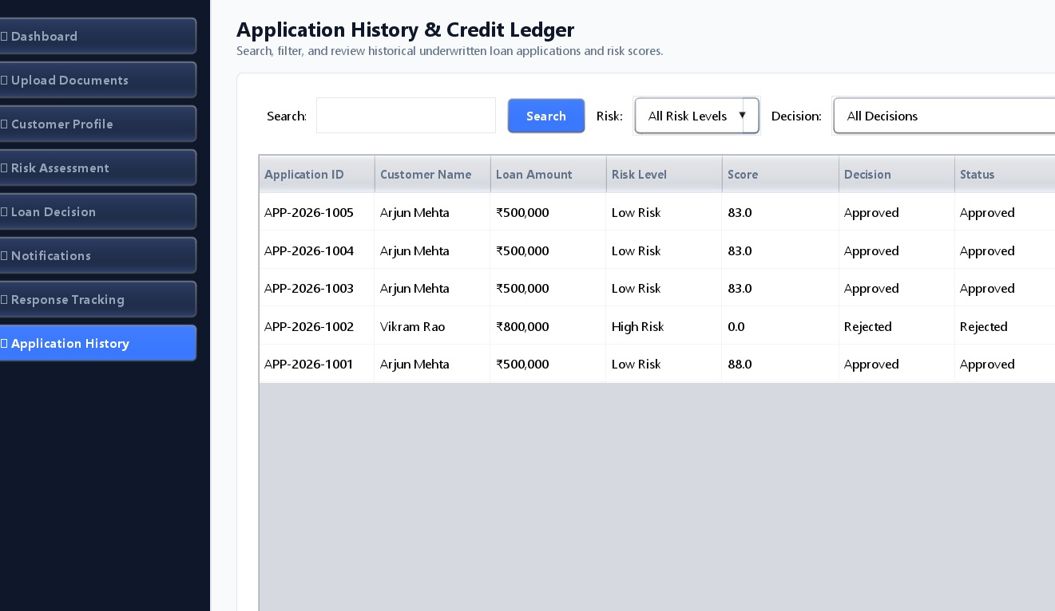

Slide 10
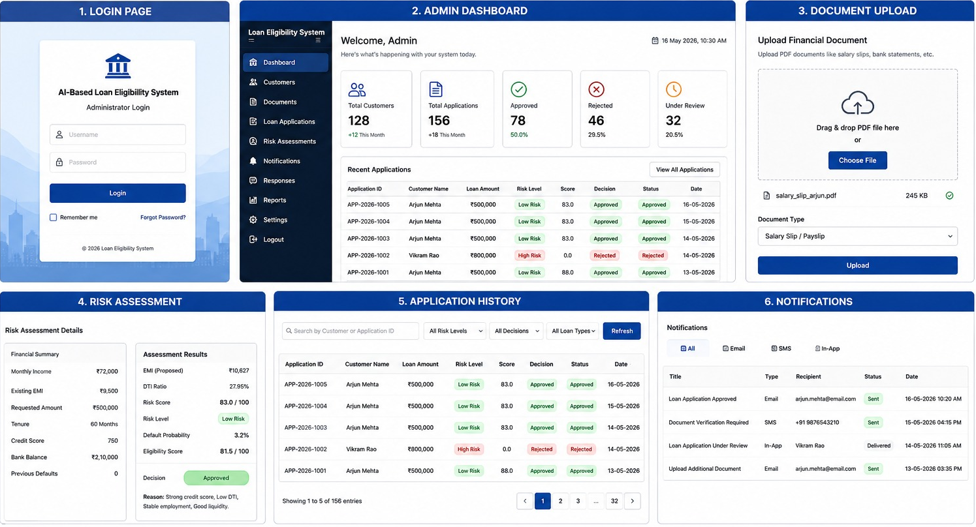
USER INTERFACE

Slide 11
TESTING
Testing Strategy: Testing is performed to verify the correctness, reliability and
integration of the major system components.
Unit Testing: JUnit 5 is used to test individual functionalities such as:
PDF extraction
EMI calculation
DTI calculation
Risk calculation
Eligibility rules
Integration Testing : Validates the interaction between:
Document Processing
Customer ProfileRisk Assessment
Database
Application Management
Expected Outputs : The testing process verifies accurate generation of:
Customer Profile, Risk Score, Risk Level, Eligibility, Decision, Application History.

Slide 12
CHALLENGES & NEXT PLAN
Key Challenges:
Unstructured Financial Documents - Financial information may appear in different formats and layouts, making automated extraction challenging.
Document Classification - The system must distinguish relevant financial documents from unrelated documents.
Data Consistency - Information extracted from multiple documents may contain variations or discrepancies.
Risk Assessment - Different financial factors must be combined into a consistent and explainable risk score.
System Integration - Maintaining consistency between the processing, risk and database modules requires careful architectural design.
Next Plan:
Integrate trained Machine Learning models
Add OCR for scanned documents
Enhance intelligent document understanding
Implement advanced fraud detection
Integrate real-time credit information
Improve automated notification services

Slide 13


